Slide 1

BACTERIAL METABOLISM
2nd Year – 1st semester
Dr. Munira Ch. Ismail

Slide 2
Introduction
Generally , bacterial cells have the same metabolic activities as eukaryotic cells.
Although bacteria can use a number of different organic carbon sources, we will use
Glucose as the growth substrate or carbon source in our discussion of energy generation via respiration and fermentation.

Slide 3
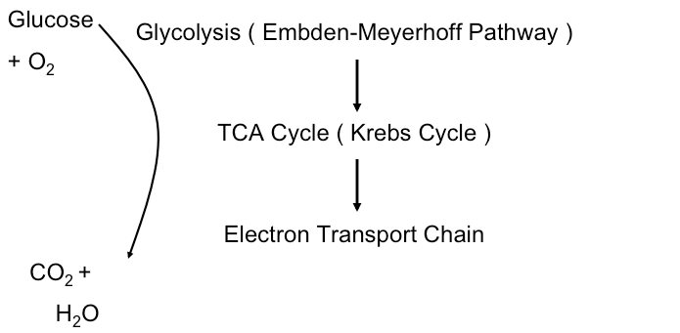

Slide 4
A. Glycolysis (Embden-Meyerhof Pathway)
In glycolysis, glucose is oxidized to pyruvate.
The transfer of electrons FROM the glucose allows the bacterium to produce ATP via direct substrate level phosphorylation.
Other electrons from the oxidized substrate are never free in are solution,but rather are transferred to NAD+ (nicotinamide adenine dinucleotide) to generate the reduced form of the molecule called NADH.
NAD⁺ + 2 e⁻ + H ⁺ → NADH
During glycolysis, 2 moles of ATP are consumed and 4 moles of ATP are produced for every mole of glucose. One equivalent of NADH is formed from
NAD⁺.

Slide 5
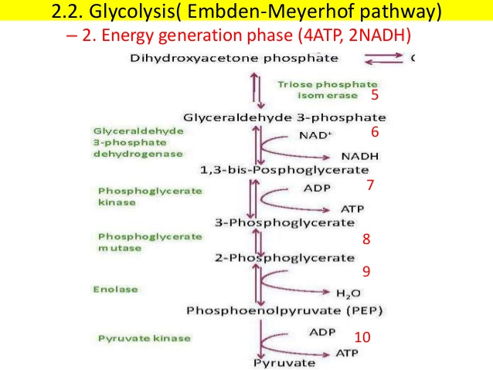

Slide 6
B. Tricarboxylic acid cycle:
liberates reducing equivalents (H which Equals a proton and an electron), that drive ATP formation via oxidative phosphorylation.
The glyoxylate shunt functions similarly to the Krebs cycle but lacks many of the Krebs cycle enzyme reactions. The glyoxylate cycle is consumes acetylCoA which is generated from acetate.
Acetate is a major product when microbes grow on fatty acids. (This pathway is generally absent in mammals.

Slide 7
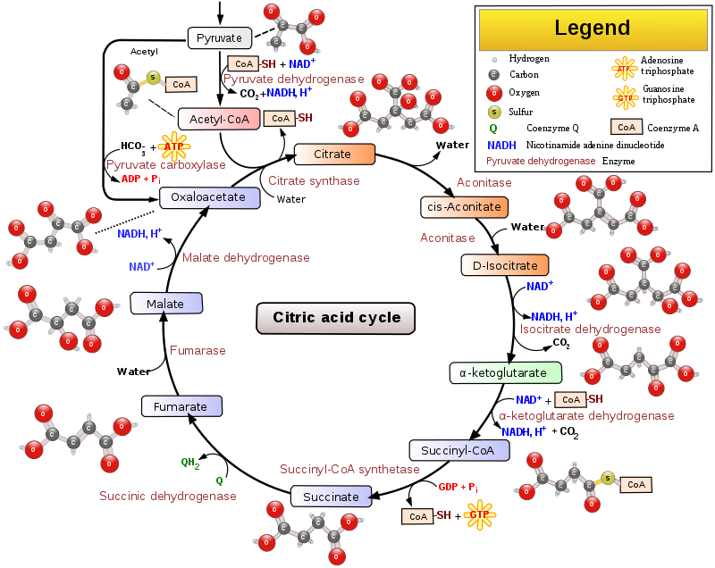

Slide 8
C. Electron transport chain
NADH donates electrons to a respiratory chain (a series of electron carriers such as cytochromes located in the inner membrane of the bacteria cell).
Transfer of electrons through the electron transport chain converts the energy of the electrons into a proton gradient. This proton gradient, in turn, is used to generate ATP via an ATPase in the inner membrane.
In aerobic respiration, the terminal electron acceptor is O2.
O₂ + 2e⁻ yields H₂O.
While mammalian cells can only respire with oxygen as the final (terminal) electron acceptor, some bacteria can respire anaerobically by using a terminal electron acceptor other than oxygen (for example, NO₃⁻ which can be reduced to N₂).
The production of ATP by this process is known as oxidative phosphoralition.
In mammalian cells, this occurs in mitochondria, in bacteria this occurs across the cytoplasmic membrane. Mitochondria very likely evolved from an endosymbiotic bacterium.

Slide 9
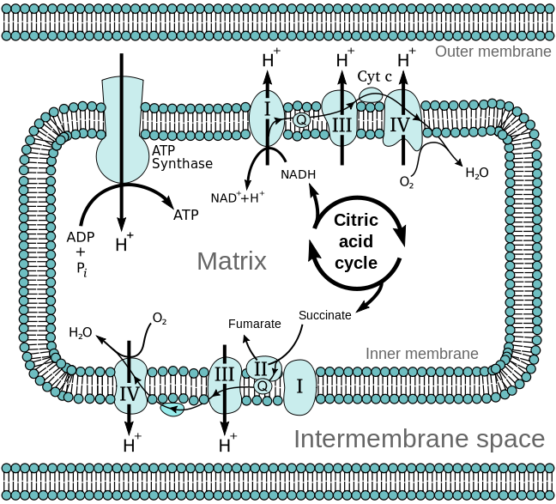
The electron transport chain in the mitochondrion is the site of oxidative phosphorylation in eukaryotes. The NADH and succinate generated in the citric acid cycle are oxidized, providing energy to power ATP synthase.

Slide 10
D. Fermentation
If there is a lack of oxygen causing the ETC and TCA cycle to “back up,” or if an organism lacks TCA cycle enzymes, some of pyruvic acid formed from glucose during glycolysis is reduced using NADH ⁺. This regenerates NAD+.
The resulting fermentation product is excreted.
ATP is made directly via the transfer of a high-energy phosphate bond to ADP. No respiratory chain is involved.
The direct synthesis of ATP during fermentation via substrate-level phosphorylation only.

Slide 11
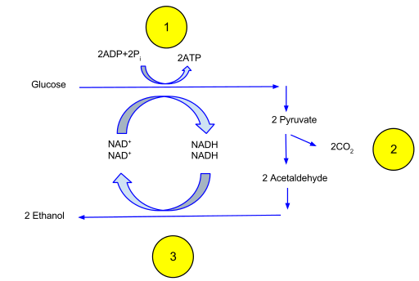

Slide 12
Aerobic respiration yields much more energy per mole of glucose than fermentation does.
Aerobic respiration:
C₆H₁₂O₆ (glucose) + 6O₂ → 6CO₂ + 6H₂O (-ΔF = 688,000 cal).
Fermentation:
C₆H₁₂O₆ (glucose) + 6O₂ → 6CO₂ + 6H₂O (-ΔF = 688,000 cal).
While most ATP in eukaryotic cells is made via respiration, fermentation is an important way for many bacterial pathogens to gain energy in the absence of oxygen.
In all cases, the fermentation product is reduced compared to pyruvate and the electrons for this reduction were those accumulated during the oxidation of the growth substrate (glucose).
Lactic acid fermentation is the most simple fermentation pattern, featuring the direct reduction of pyruvic acid by NADH and the enzyme lactic dehydrogenase. (Lactate dehydrogenase is also present in human muscle tissue.)

Slide 13
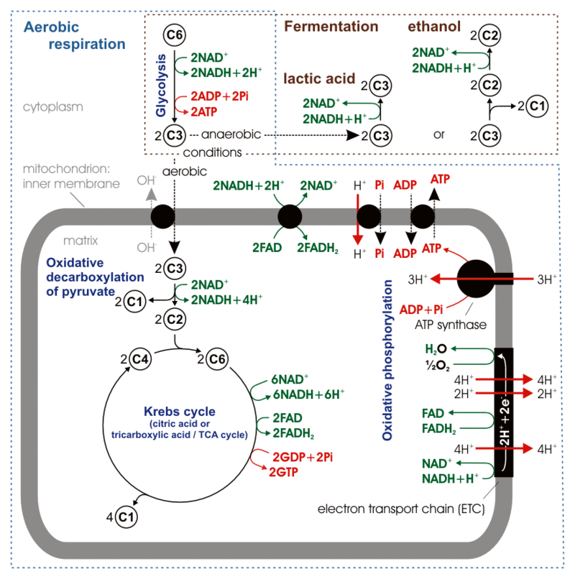

Slide 14
Home work 3
A comparison of Respiration and Fermentation

Slide 15
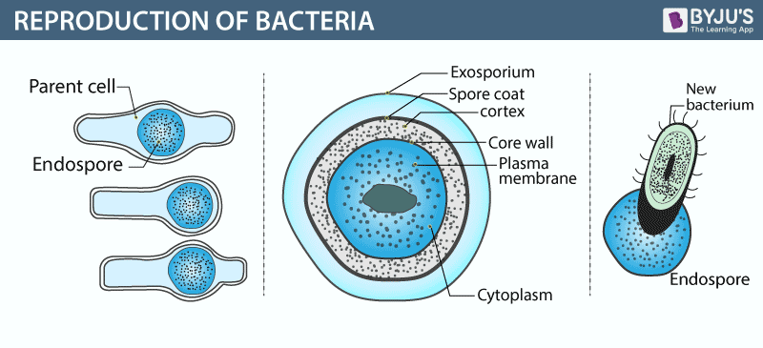
Reproduction of Bacteria

Slide 16
Bacteria follow the asexual mode of reproduction called binary fission. A single bacterium divides to give two daughter cells. These are identical to the parent cell as well as to each other. Replication of DNA within parent bacterium marks the beginning of the fission. Eventually, cell elongates to form two daughter cells. The rate and timing of reproduction depend on the conditions like temperature and availability of nutrients. When there is a favorable condition, E. coli or Escherichia coli produces about 2 millions of bacteria in every 7 hours.

Slide 17
What Is Binary Fission?
​Binary fission is a type of cell division in which a parent cell copies it’s genetic material, and then divides, transforming into two daughter cells, each new cell having one complete copy of the genetic instructions necessary to run the cell. The daughter cells are clones (exact copies) of the parent cell that gave rise to them.

Slide 18
Steps of Binary Fission:
After the septum forms completely, depending on the type of microbe, the daughter cells may remain Parent cell grows to its maximum size.
Cell duplicates its chromosome (a process called replication) so that two exact copies of the genetic material exist inside the parent cell. These two molecules of DNA are attached to the cell’s plasma membrane.
The cell then grows, increasing the distance between the two duplicated chromosomes that are attached to the plasma membrane.
In prokaryotes (bacteria and Archaea), a new cell wall, called a septum, begins to grow across the middle of the cell, bisecting it. Amoeba, which do not have a cell wall, develop a cleavage furrow that pinches the cell in half.
attached to each other, or may completely separate. Whether attached or separated, each cell is an independent unit.

Slide 19
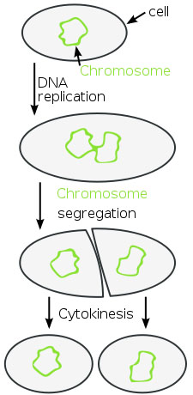

Slide 20


